Slide 1

Object-Oriented Software Analysis & Design (COMP-3220) Lecture 3 Decorator Pattern
School of Computer Science
Faculty of Science
University of Windsor
Dr. Saeed Samet

Slide 2
Big Data Analytics and Database Design
Motivation
How to add behavior to individual objects dynamically without exploding our class hierarchy or violating good OO principles.
In naïve designs, when we want variations of behavior, we often reach for inheritance:
Base class: Coffee
Variants: MilkCoffee, SugarCoffee, MilkSugarCoffee, WhippedMilkSugarCoffee, …
This quickly becomes combinatorial. Each new feature multiplies the number of subclasses. Worse, these combinations are fixed at compile time.
The key idea
The Decorator Pattern replaces inheritance-based extension with composition-based layering.
Instead of creating new subclasses, we:
Keep a simple core object
Wrap it with one or more “decorator” objects
Each decorator adds a small piece of behavior

Slide 3

Big Data Analytics and Database Design
Motivation
“wrap” an object with additional behavior the same way you wrap a gift—layer by layer—without changing what’s inside

Slide 4
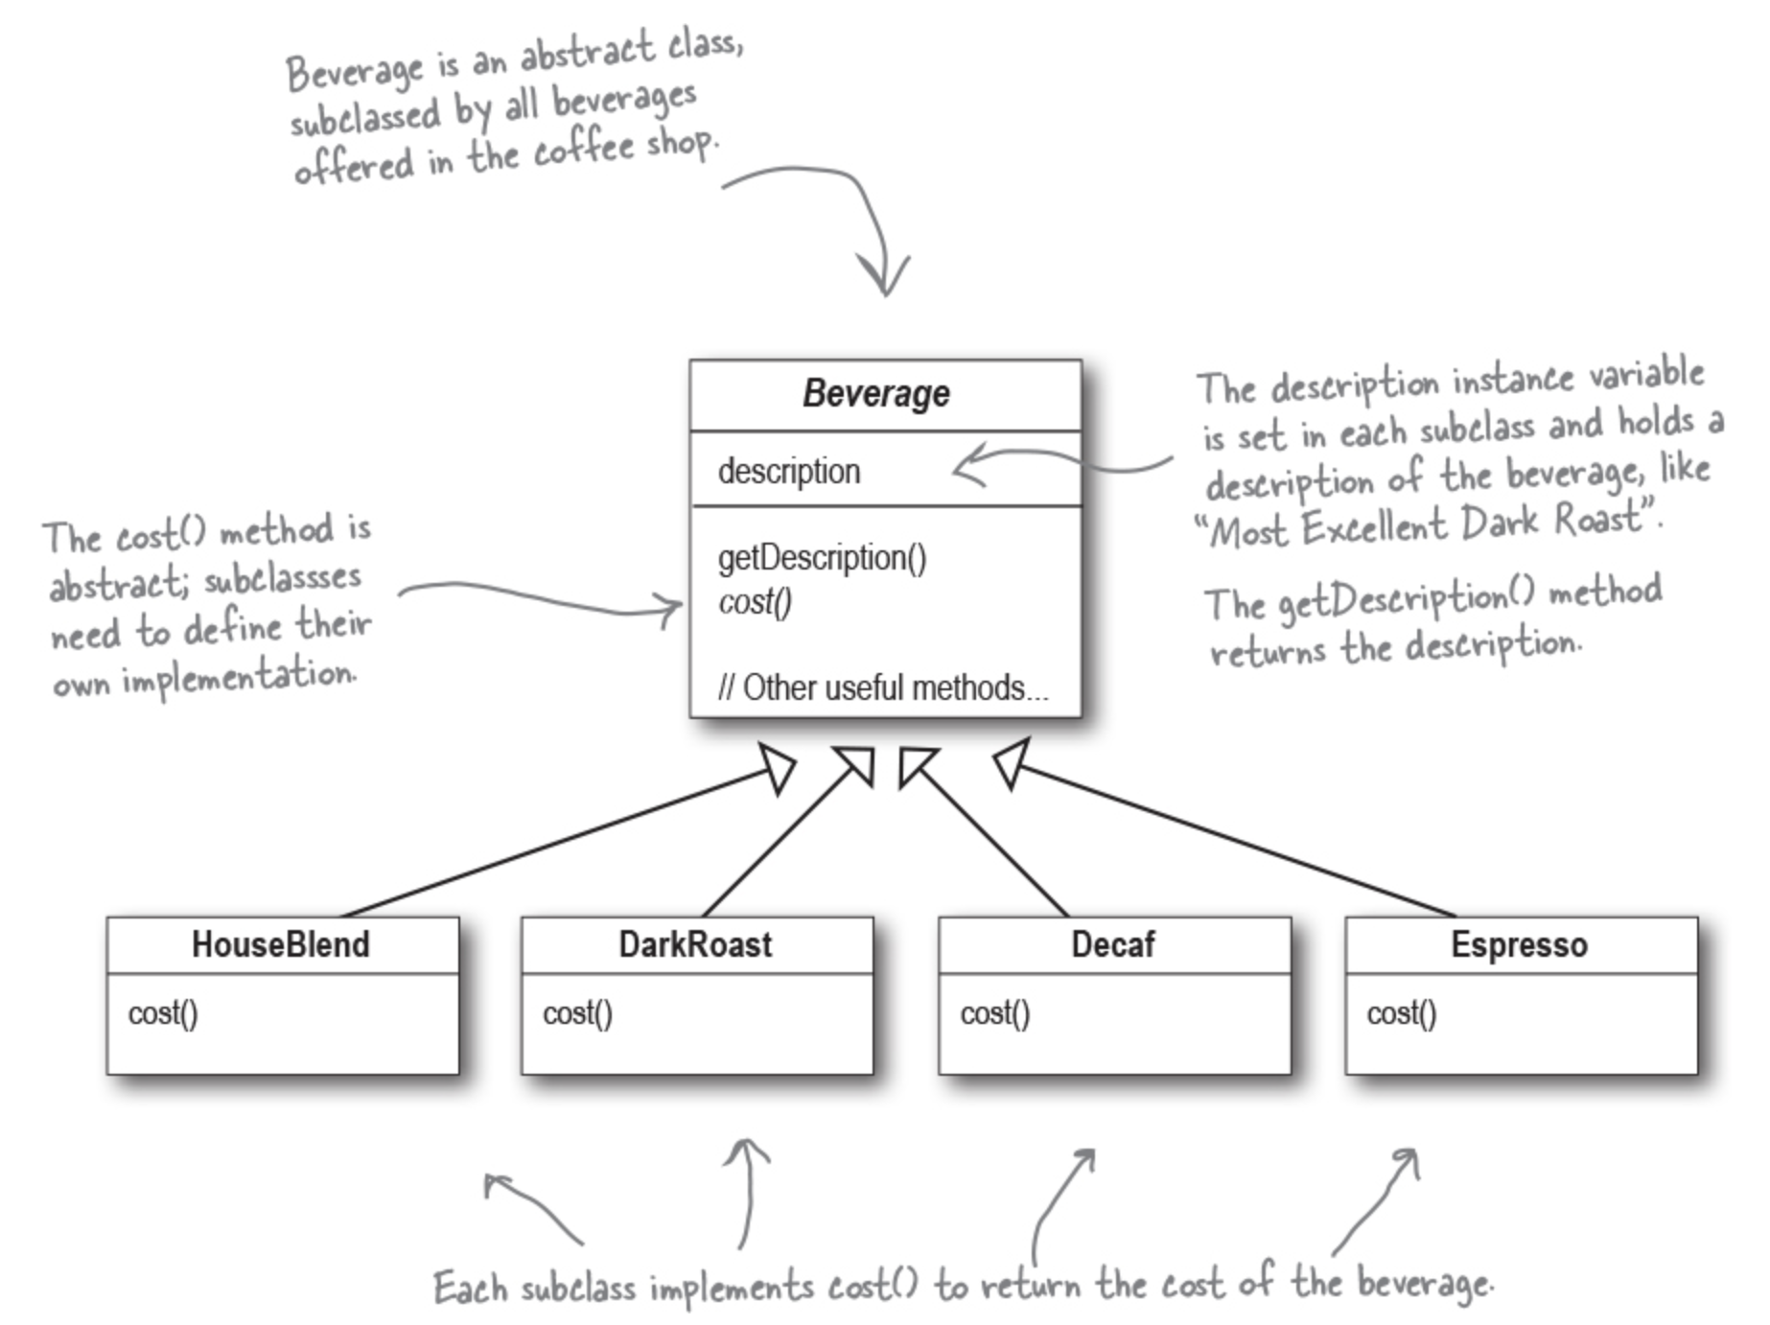
Big Data Analytics and Database Design
Welcome to Starbuzz Coffee
They are scrambling to update their ordering systems to match their beverage offerings. When they first went into business, they designed their classes like this...

Slide 5
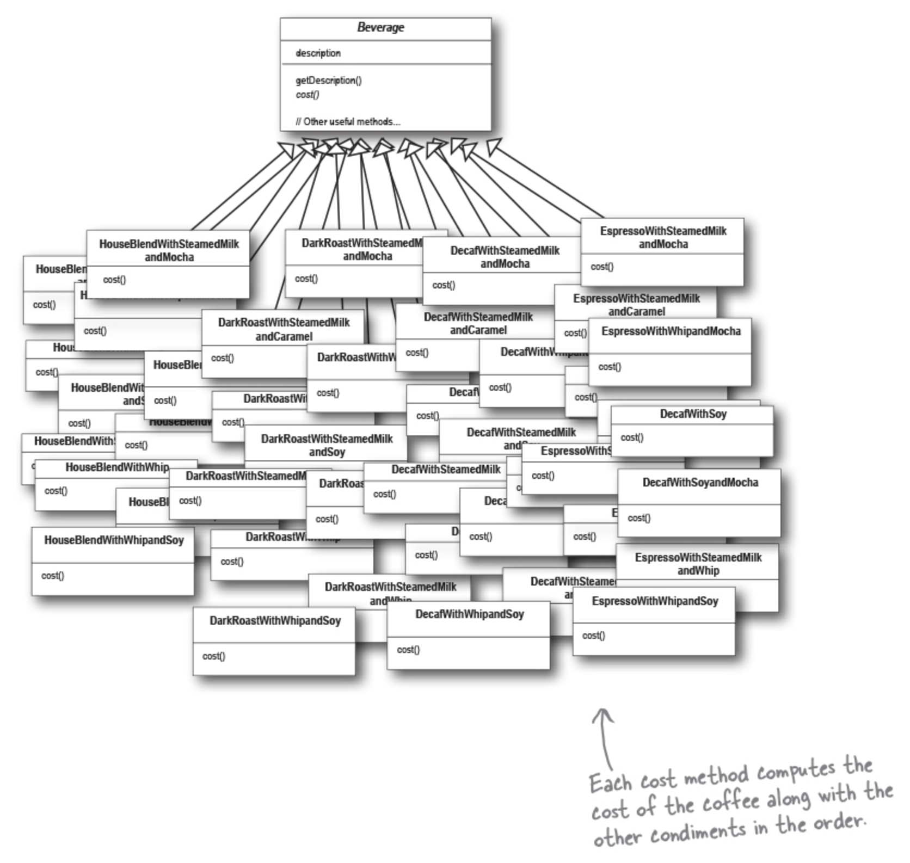
Big Data Analytics and Database Design
A bit for each condiment
In addition to your coffee, you can also ask for several condiments like steamed milk, soy, and mocha, and have it all topped off with whipped milk. Starbuzz charges a bit for each condiment, so they really need to get them built into their order system.
Here’s their first attempt...

Slide 6
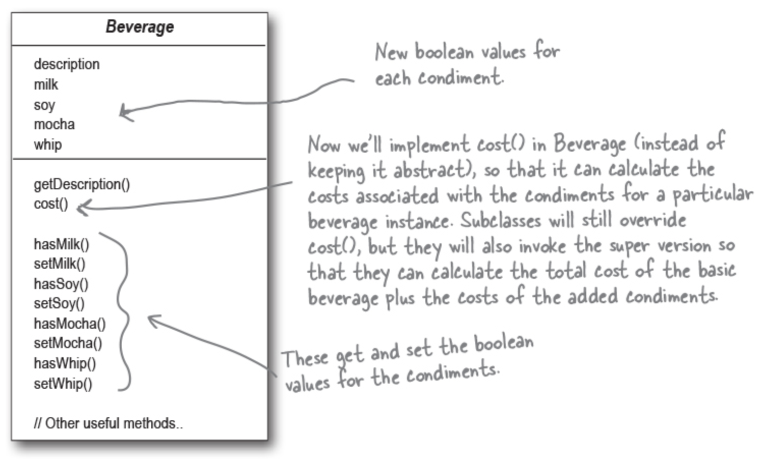
Big Data Analytics and Database Design
Solution
Let’s start with the Beverage base class and add instance variables to represent whether or not each beverage has milk, soy, mocha, and whip...

Slide 7
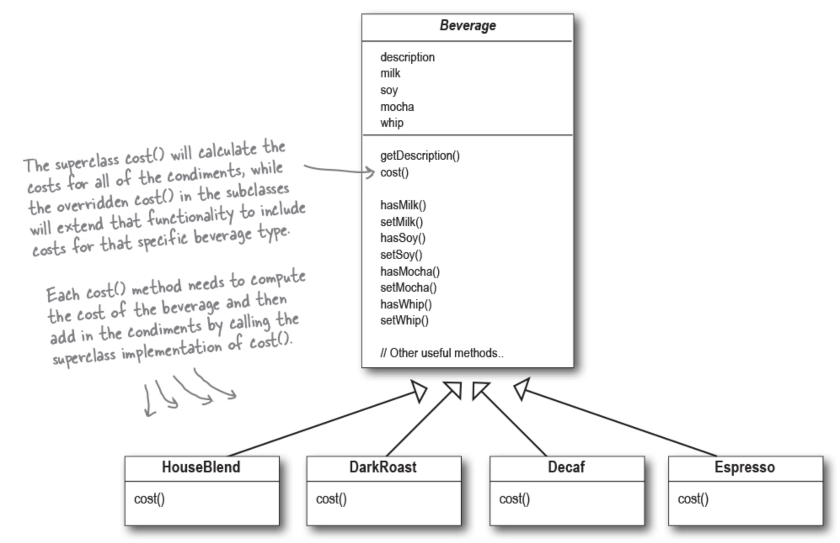
Big Data Analytics and Database Design
Solution
Now let’s add in the subclasses, one for each beverage on the menu:

Slide 8
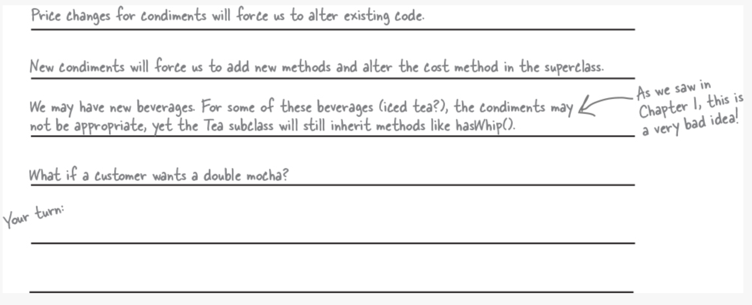
Big Data Analytics and Database Design
Questions
What requirements or other factors might change that will impact this design?

Slide 9
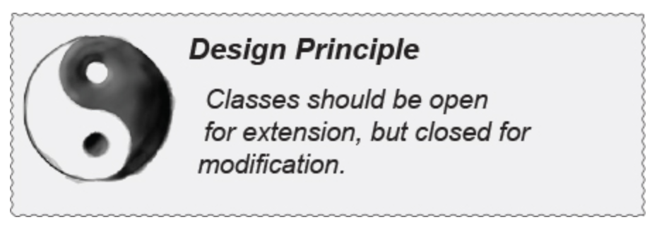
Big Data Analytics and Database Design
The Open-Closed Principle
We’re on to one of the most important design principles:
Our goal is to allow classes to be easily extended to incorporate new behavior without modifying existing code.
What do we get if we accomplish this?
Designs that are resilient to change and flexible enough to take on new functionality to meet changing requirements.

Slide 10
Big Data Analytics and Database Design
Meet the Decorator Pattern
Representing beverage and condiments with inheritance has not worked out very well.
We get class explosions and rigid designs, or
We add functionality to the base class that isn’t appropriate for some of the subclasses.
So, we’ll start with a beverage and “decorate” it with the condiments at runtime. For example, if the customer wants a Dark Roast with Mocha and Whip, then we’ll:
Start with a DarkRoast object.
Decorate it with a Mocha object.
Decorate it with a Whip object.
Call the cost() method and rely on delegation to add up the condiment costs.
But how do you “decorate” an object, and how does delegation come into this? A hint: think of decorator objects as wrappers.

Slide 11
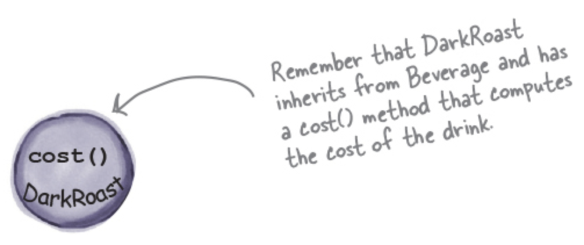
Big Data Analytics and Database Design
Constructing a drink order with Decorators
We start with our DarkRoast object.

Slide 12
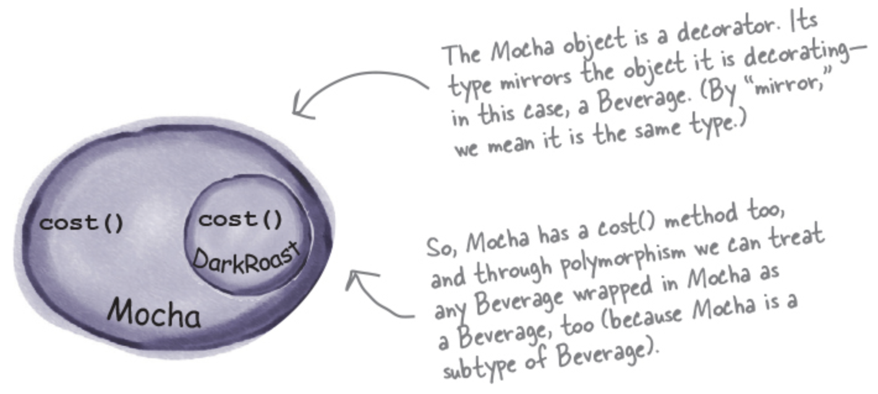
Big Data Analytics and Database Design
Constructing a drink order with Decorators
The customer wants Mocha, so we create a Mocha object and wrap it around the DarkRoast.

Slide 13
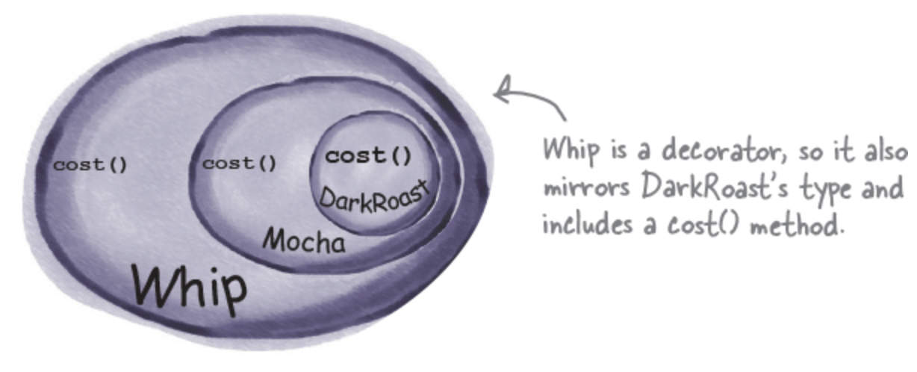
Big Data Analytics and Database Design
Constructing a drink order with Decorators
The customer also wants Whip, so we create a Whip decorator and wrap Mocha with it.

Slide 14
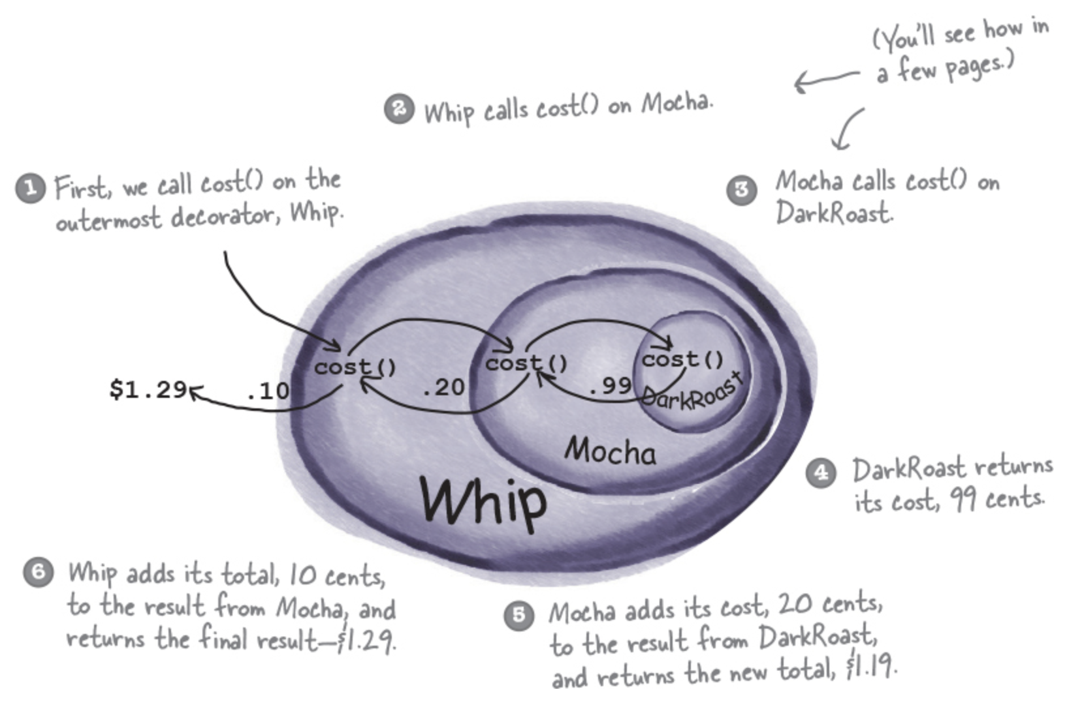
Big Data Analytics and Database Design
Constructing a drink order with Decorators
Compute the cost for the customer by calling cost() on the outermost decorator, Whip, and Whip is going to delegate computing the cost to the objects it decorates. And so on…

Slide 15
Big Data Analytics and Database Design
Decorators
Decorators have the same supertype as the objects they decorate.
You can use one or more decorators to wrap an object.
Given that the decorator has the same supertype as the object it decorates, we can pass around a decorated object in place of the original (wrapped) object.
The decorator adds its own behavior before and/or after delegating to the object it decorates to do the rest of the job.
Objects can be decorated at any time, so we can decorate objects dynamically at runtime with as many decorators as we like.

Slide 16
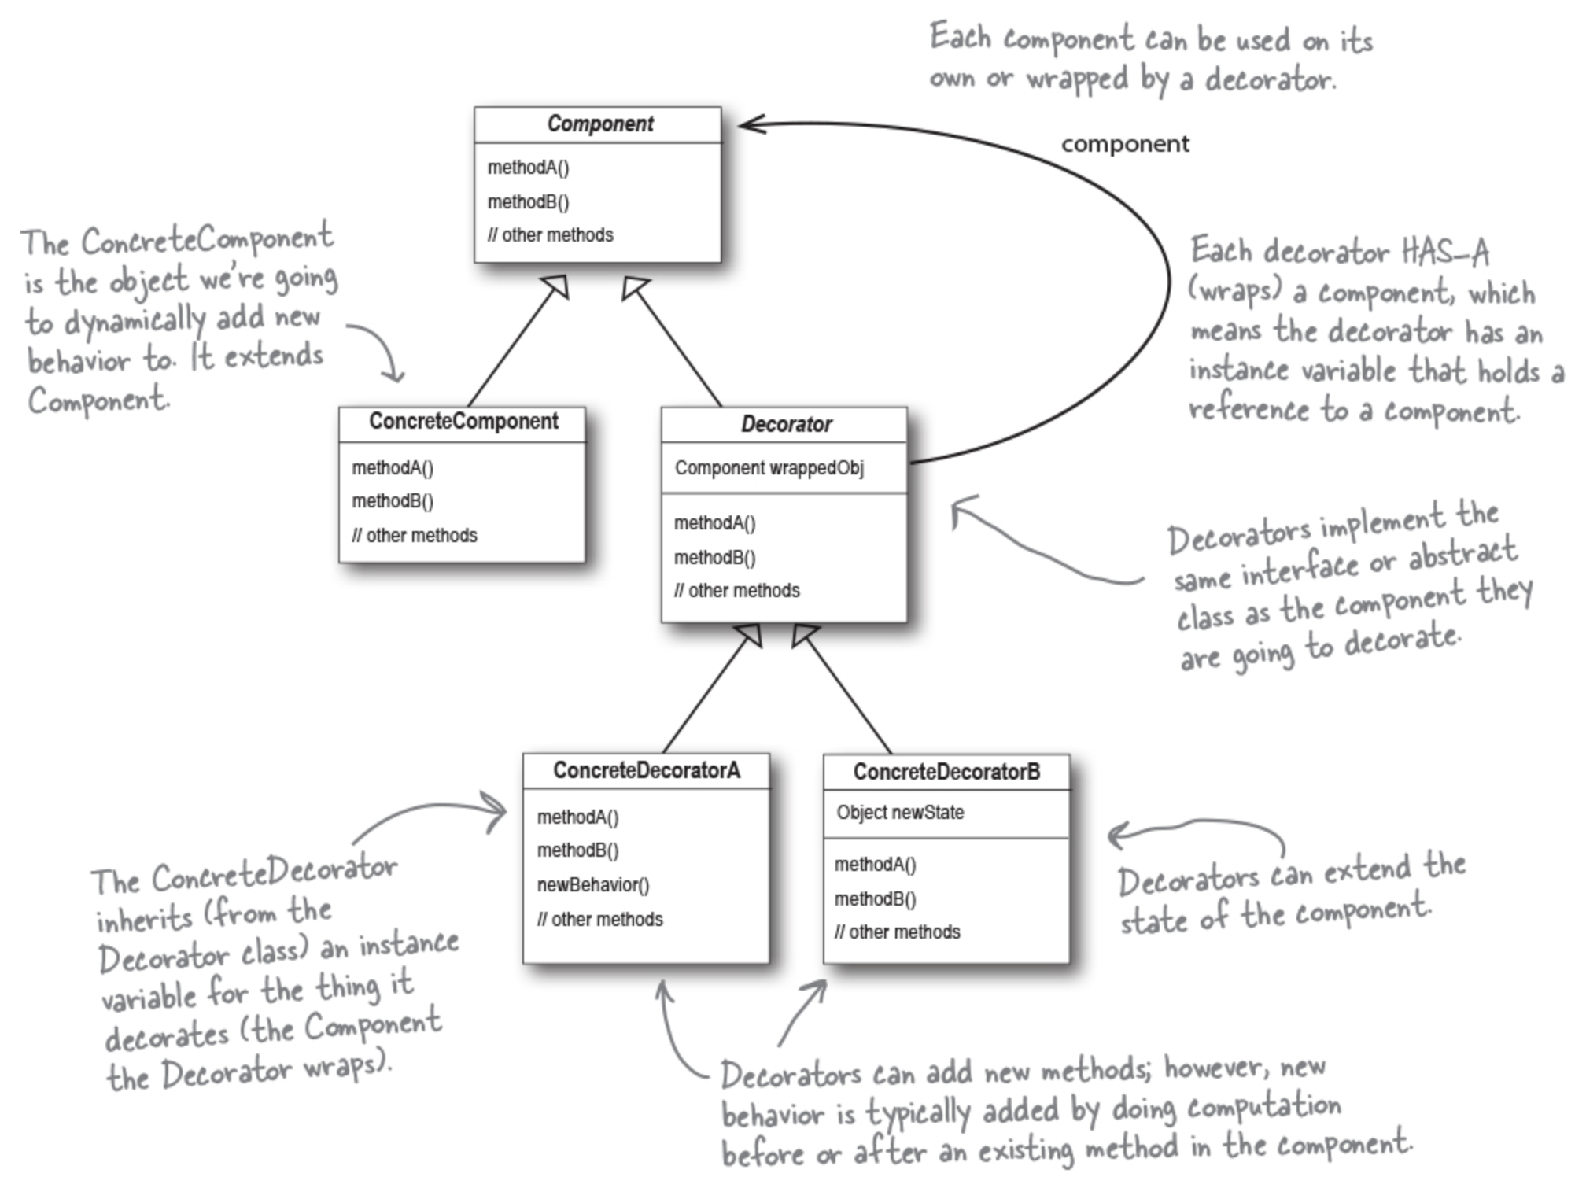
Big Data Analytics and Database Design
The Decorator Pattern defined
The Decorator Pattern attaches additional responsibilities to an object dynamically.
They provide a flexible alternative to subclassing for extending functionality.

Slide 17
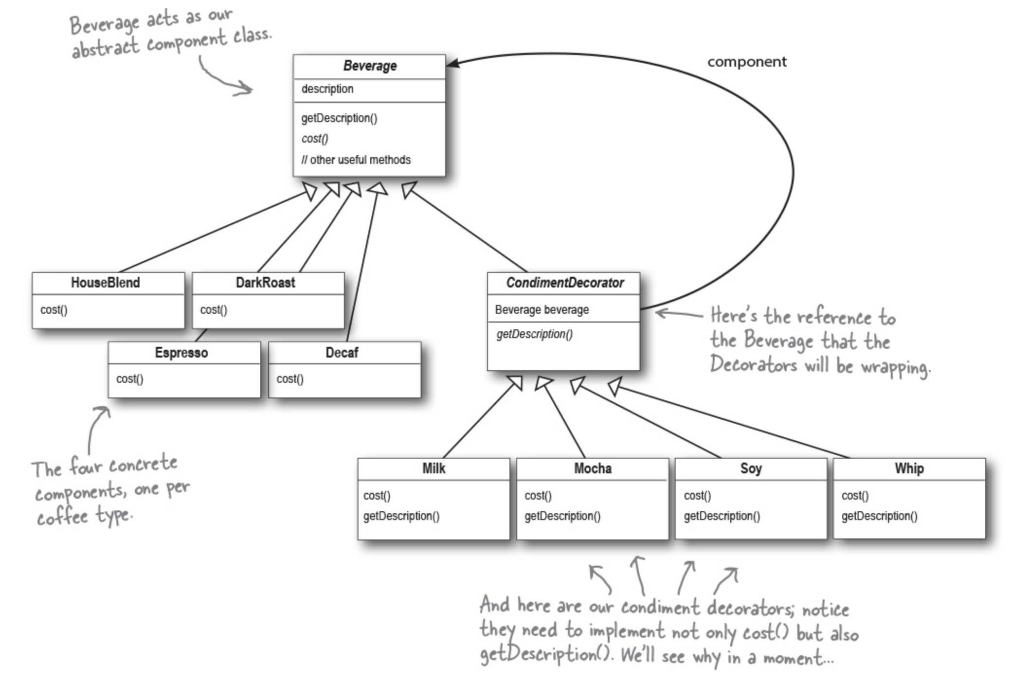
Big Data Analytics and Database Design
Decorating our Beverages

Slide 18
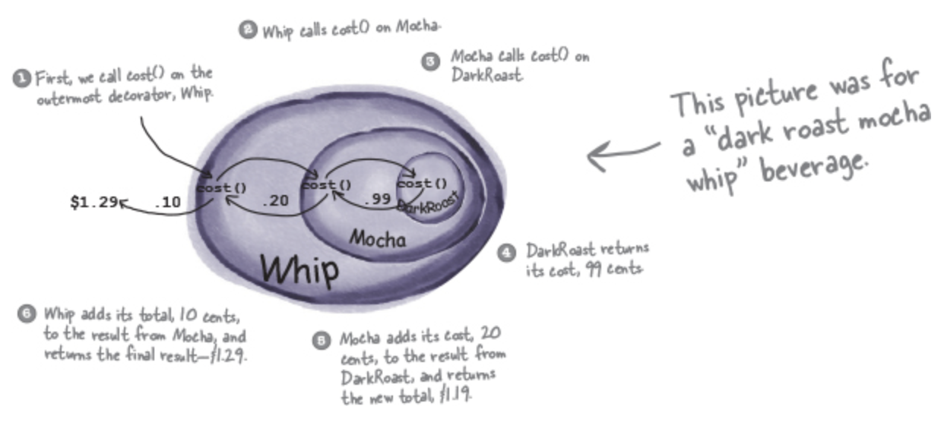
Big Data Analytics and Database Design
New barista training
Make a picture for what happens when the order is for a “double mocha soy latte (HouseBlend) with whip” beverage, by getting help from the previous order, below.

Slide 19
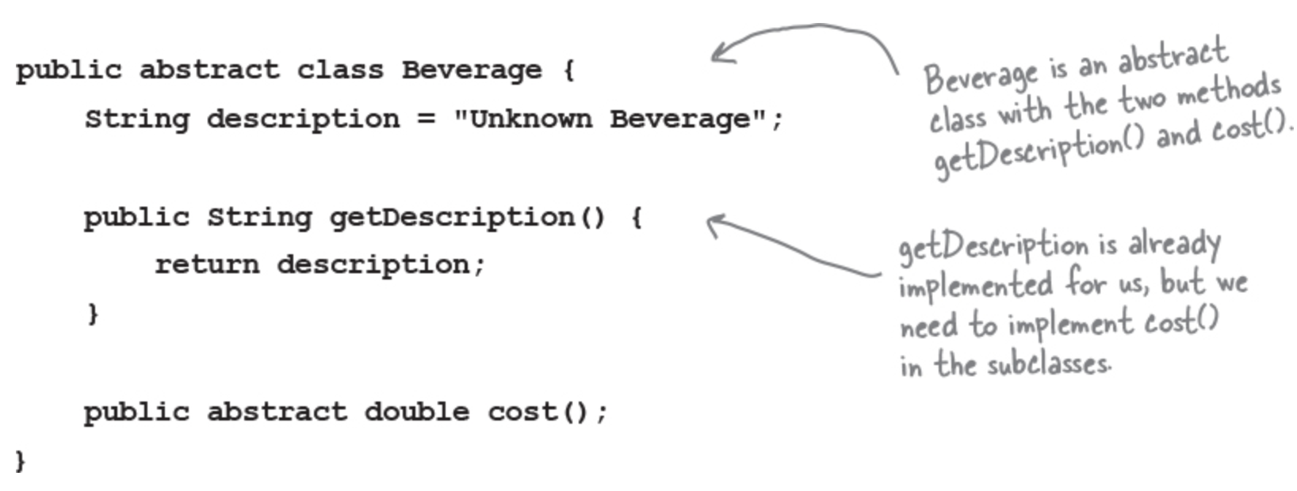
Big Data Analytics and Database Design
Writing the Starbuzz code
Let’s start with the Beverage class, which doesn’t need to change from Starbuzz’s original design. Let’s take a look:

Slide 20
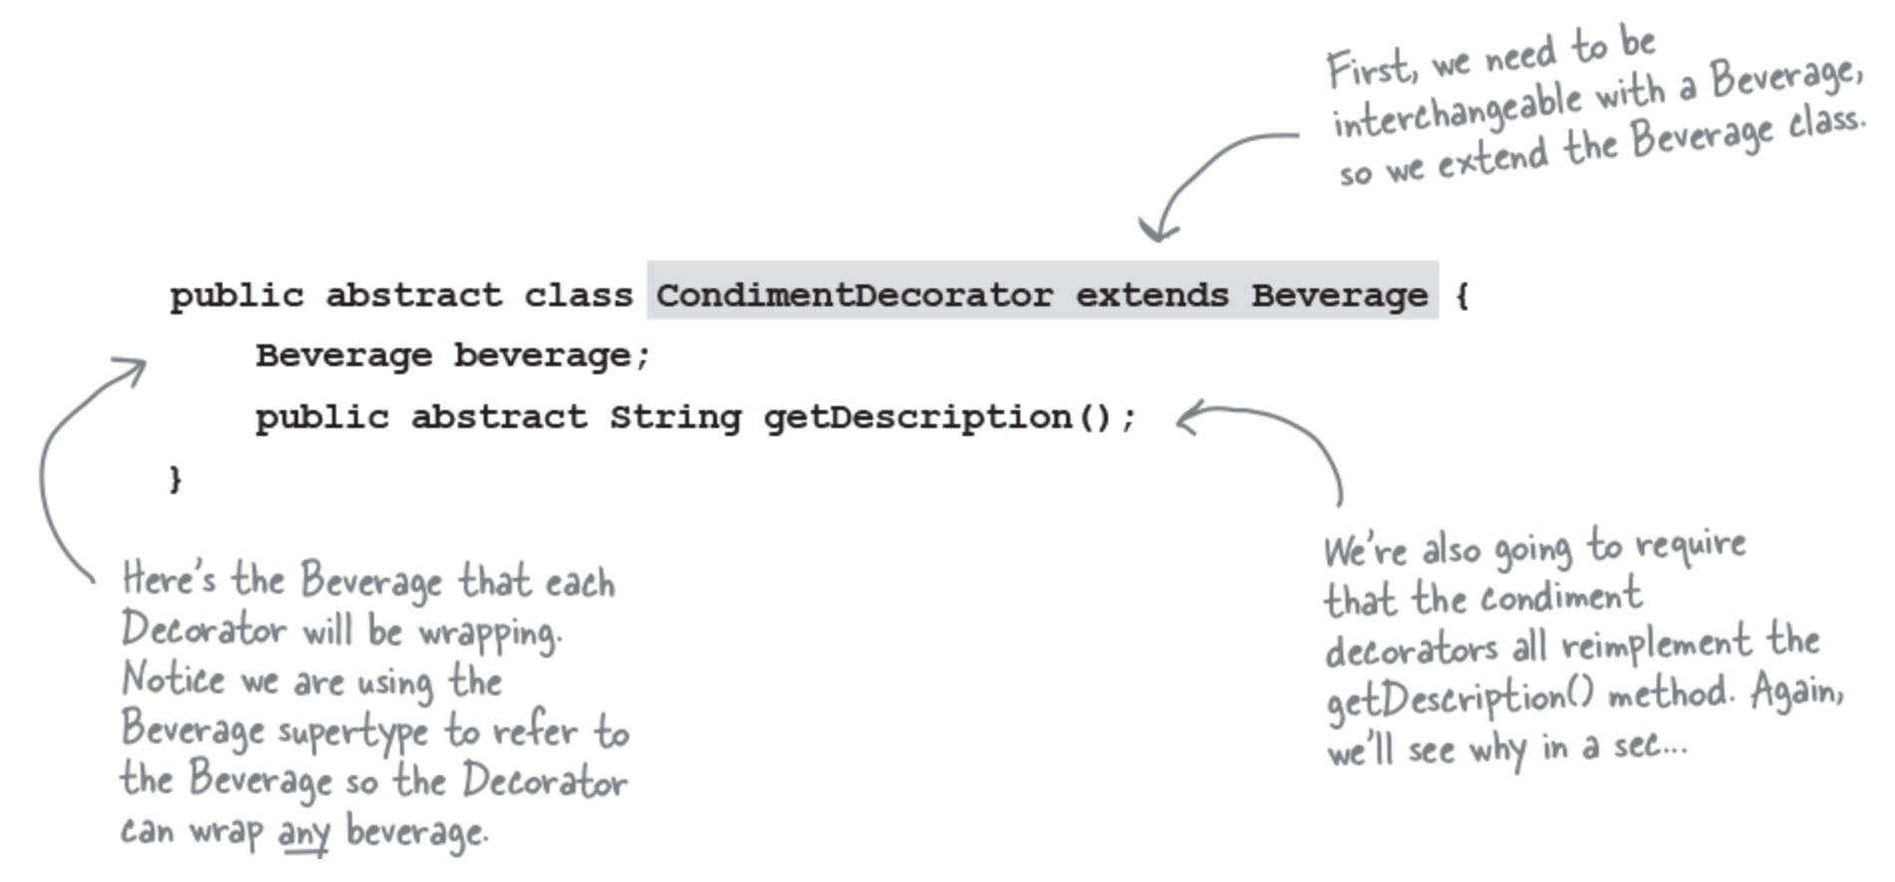
Big Data Analytics and Database Design
Writing the Starbuzz code
Now, let’s implement the abstract class for the Condiments (the Decorator) as well:

Slide 21
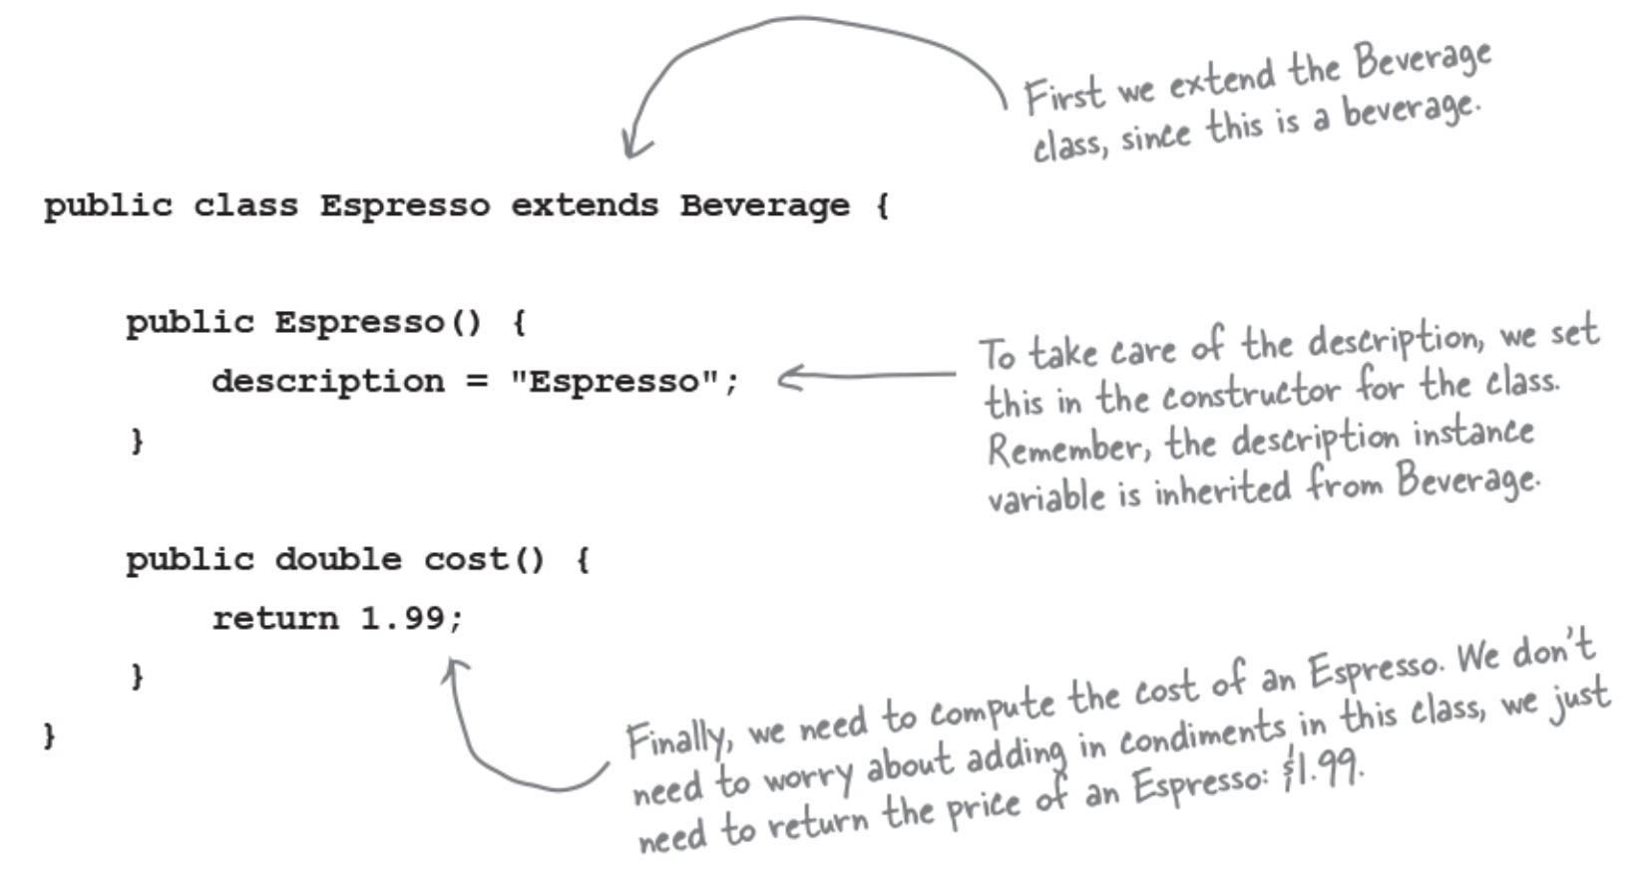
Big Data Analytics and Database Design
Coding beverages
Now let’s implement some beverages. We’ll start with Espresso. Remember, we need to set a description for the specific beverage and also implement the cost() method.

Slide 22
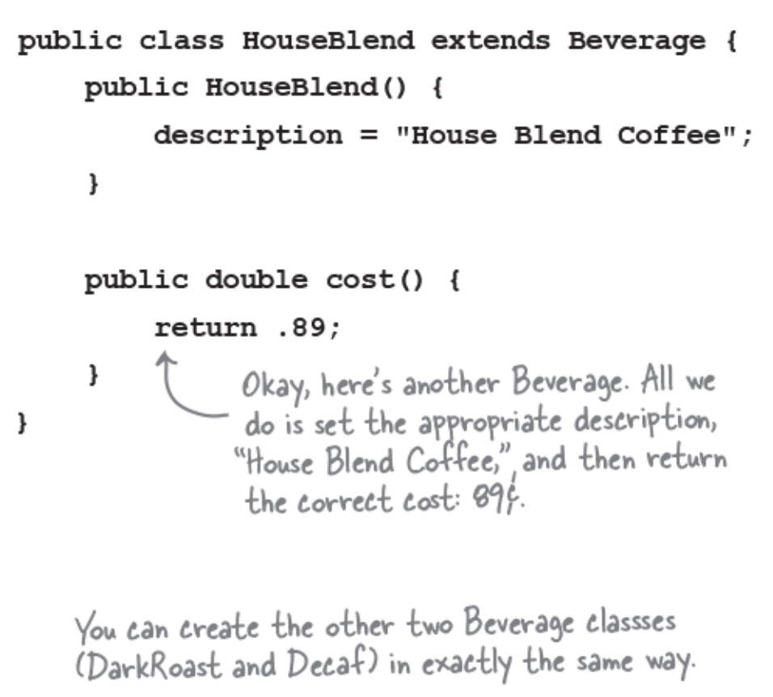
Big Data Analytics and Database Design
Coding beverages
And HouseBlend:

Slide 23
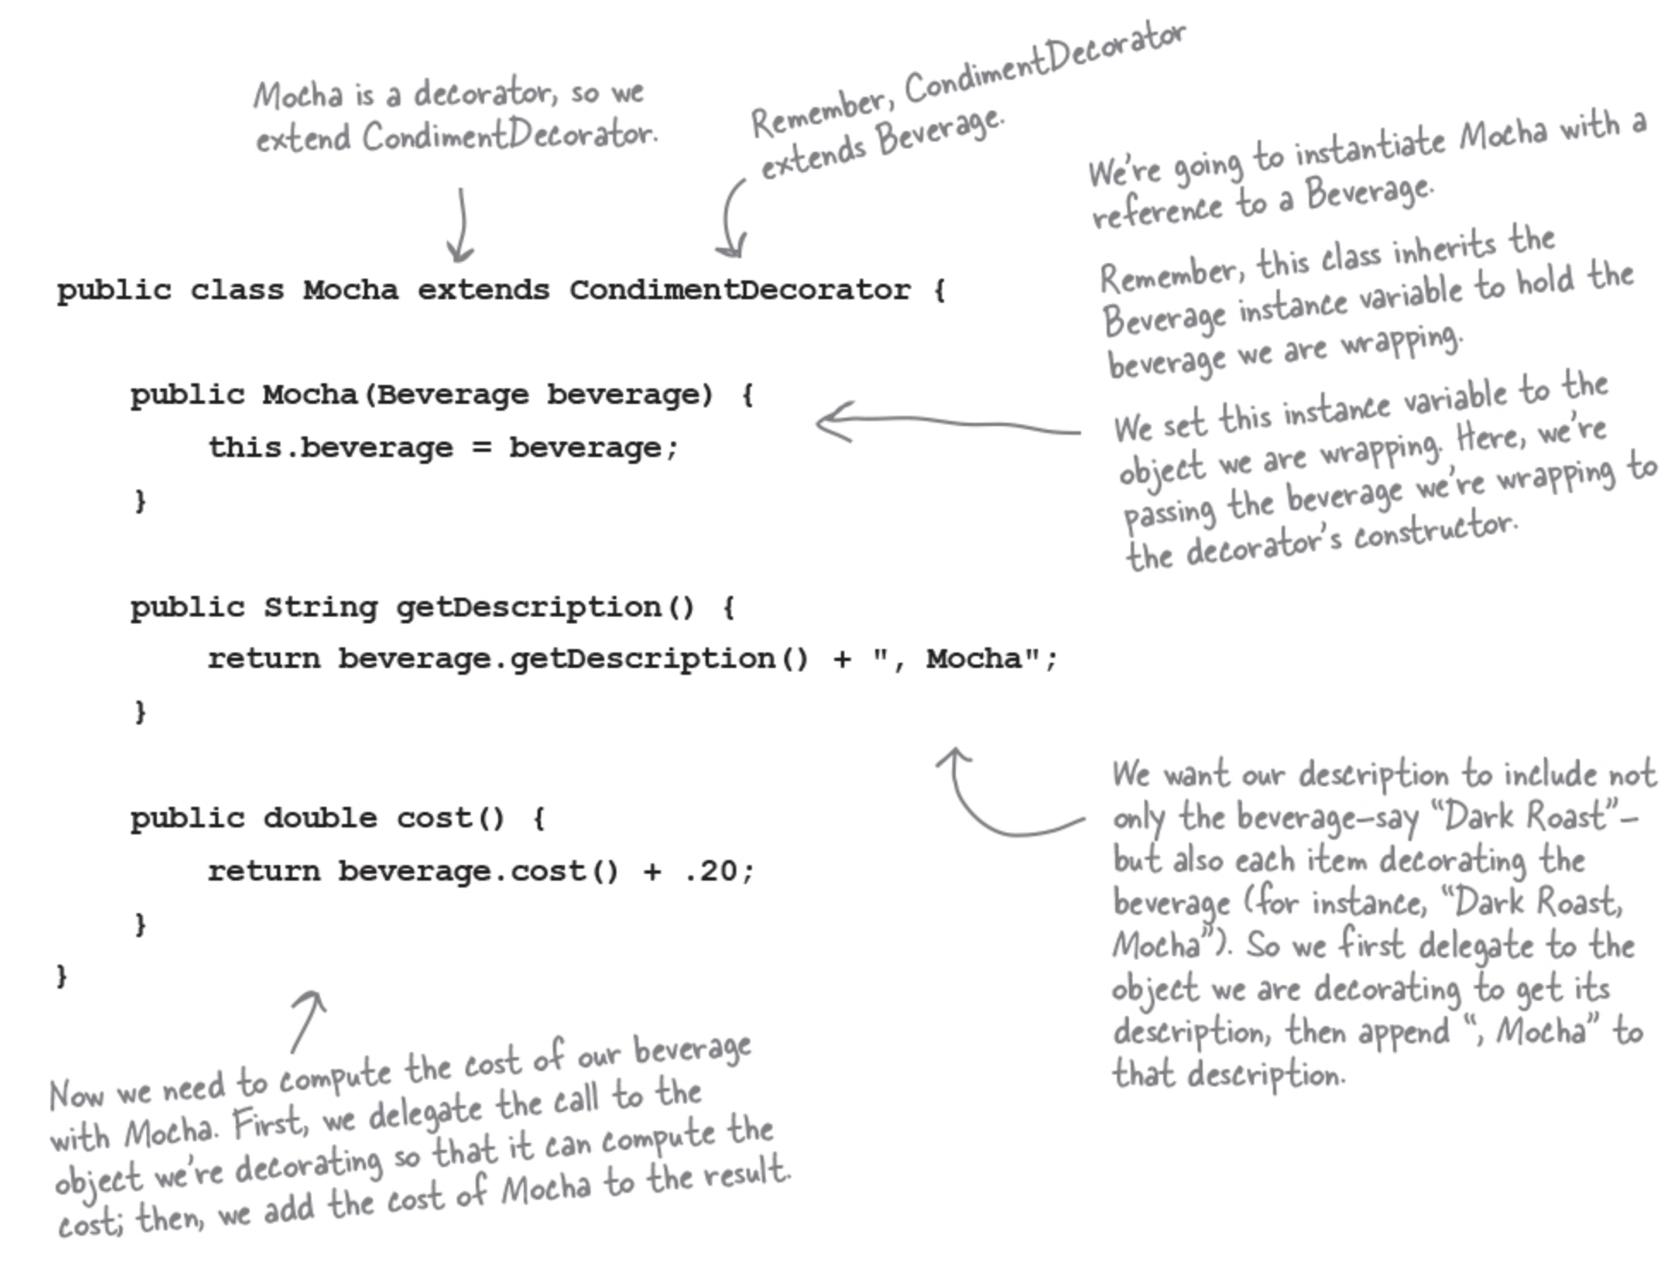
Big Data Analytics and Database Design
Coding condiments
Now it’s time to implement the concrete decorators. Here’s Mocha:

Slide 24
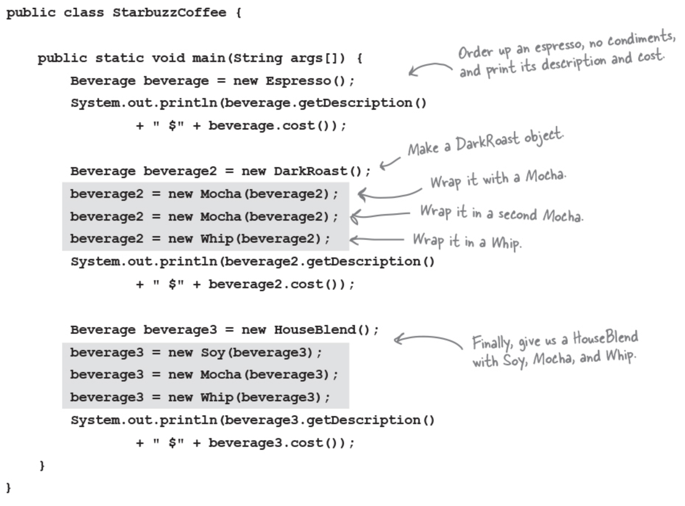
Big Data Analytics and Database Design
Serving some coffees
Test code to make orders:

Slide 25
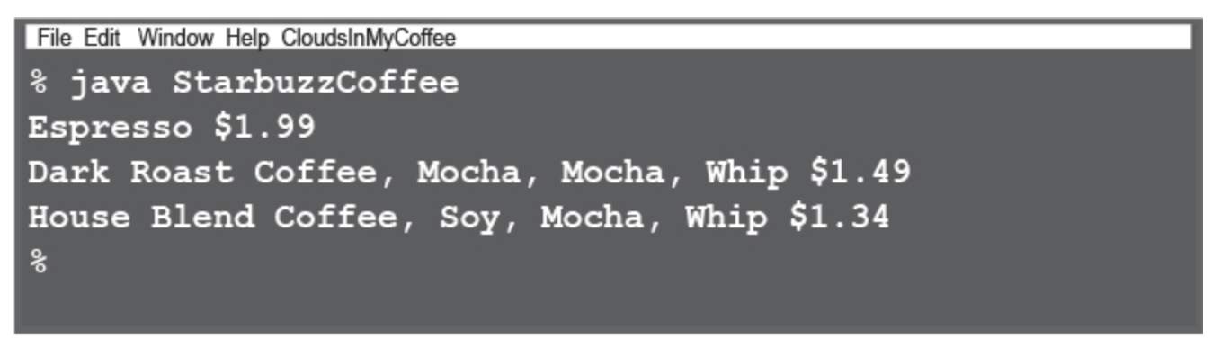
Big Data Analytics and Database Design
Serving some coffees
Now, let’s get those orders in:

Slide 26
Big Data Analytics and Database Design
Add Size
Starbuzz has introduced sizes to their menu. We can now order a coffee in tall, grande, and venti sizes (translation: small, medium, and large).
Starbuzz added two methods to the Beverage class: setSize() and getSize().
They’d also like for the condiments to be charged according to size, so for instance, Soy costs 10¢, 15¢, and 20¢, respectively, for tall, grande, and venti coffees. The updated Beverage class is shown below.
How would you alter the decorator classes to handle this change in requirements?
public abstract class Beverage {
public enum Size { TALL, GRANDE, VENTI };
Size size = Size.TALL;
String description = “Unknown Beverage”;
public String getDescription() {
return description;
}
public void setSize(Size size) {
this.size = size;
}
public Size getSize() {
return this.size;
}
public abstract double cost();
}

